Slide 1
Announcements
Newly revamped 5 Week FTI Training launched today!
Webinars last week: Vitality Bowls and Building Kidz
Webinars this week: Tomorrow - Service Team of Professionals, Wednesday - Naturals 2 Go, Friday - Utopia Home Care
Quote of the week, “ Most people think “selling” is the same as “talking”. But the most effective salespeople know that listening is the most important part of their job.” – Roy Bartell

Slide 2
Advanced Sales… Back to Fundamentals
Executive Mentoring Forum
Monday, February 6, 2017
Host: Paul Segreto

Slide 3
Rules of Sales Success
Establish and maintain a positive attitude
Believe in yourself
Make a plan…set and achieve goals
Learn and execute sales fundamentals
Understand the client and meet his/her needs
Sell to help
Establish long-term relationships
Believe in what your selling
Always be prepared
Always be sincere
Be on time for calls, appointments and follow-up
Look and sound professional
Establish rapport and client confidence

Slide 4
Rules of Sales Success (Continued)
Use humor strategically
Master total knowledge of what you’re selling
Sell benefits, not features
Always tell the truth
Always keep your promises
Don’t dog the competition
Listen more than you speak
Anticipate responses – statements and objections
Overcome objections
Ask for the sale
Shut up after asking closing question
If sale not made, make firm appointment for follow-up
Follow up… Persist until you succeed

Slide 5
Rules of Sales Success (Continued)
Redefine their rejection
Find your success formula through numbers
Do what you do passionately
Create positively memorable experiences at all times

Slide 6
Five Degrees of Failing
Failing to do your best
Failing to learn the science of selling
Failing to accept responsibility
Failing to meet pre-set goals
Failing to have a positive attitude
Success is a level of performance and self-confidence brought about by winning experiences. Failure is not about insecurity. It’s about lack of execution.

Slide 7
Why do salespeople fail?
Answer YES or NO…
  I watch the news for I hour each day.
  I read the paper each day.
  I read a news magazine every week.
  My work is a drag.
  I get angry for an hour or more.
  I talk to and commiserate with negative people.
  I look to blame others when something goes wrong.
  When something goes wrong or bad, I tell others.
  I get angry at my spouse and don’t talk for more than 4 hours.
  I bring personal problems to my work and discuss them.
  I expect and plan for the worst.
  I’m affected by bad weather enough to talk about it

Slide 8
How did you do?
0-2 yes answers: You have a positive attitude.
3-6 yes answers: You have a negative attitude.
7 or more yes answers: You have a problem attitude.
Let’s talk about this…

Slide 9
Are you born to sell? No, you learn to earn!
Answer YES or No…
  I have set my goals in writing.
  I have good self discipline.
  I am self-motivated.
  I want to be more knowledgeable.
  I want to build relationships.
  I am self-confident.
  I like myself.
  I love people.
  I love a challenge.
  I love to win.
  I can accept rejection with a positive attitude.
  I can handle the details.
  I am loyal.
  I am enthusiastic.
  I am observant.

Slide 10
Questions (continued)
I am a good listener.
I am perceptive.
I am a skillful communicator.
I am a hard worker.
I want to be financially secure.
I am persistent.

Slide 11
How did you do?
Answer over 15 with an honest yes and you’ve got what it takes.
Between 10 and 14, it could go either way – better chance if you answered yes to knowledge, enthusiasm, self-confident, perceptive, self-motivated, persistent)
Under 10…

Slide 12
Do you have a self-imposed handicap?
Stop blaming circumstances.
Stop blaming other people.
Get to know your clients better each time.
Persist until you succeed.
Know where you are at all times.
Work on your skills every day.
Become solution oriented.

Slide 13
How do clients want to be treated?
Just provide facts.
Tell the truth but don’t use the word, honestly.
Be ethical.
Talk about a few other clients.
Explain payment options.
Provide choices but give consultative recommendation.
Reinforce choices.
Don’t argue or confuse or talk down.
Don’t position with negatives.
Listen more than you speak.
Take a genuine interest.
Lose the used car approach.
Help client buy, don’t sell.

Slide 14
How do you find the elusive hot button?
Ask questions about status and situation.
Ask questions about issues of pride.
Ask questions about personal interests.
Ask about wishes, hopes and dreams.
Ask goal-related questions.
Listening is the hard part. Listening is the important part. The hot button is in the client’s responses!

Slide 15

Questions
On the topic
Deal help
Franchisor help
Marketing lead questions

Slide 16
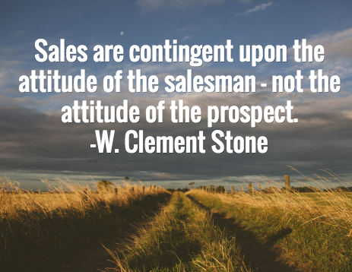

Slide 17
