Slide 1
Franchise Matches for Cara Cooper
Powered by franchise brokers association

Slide 2
Cara’s Requirements
Strong Proven Brand
Verifiable Success
Franchise that is not saturated
Gave back to the community
Low risk
Scalable
Brand needs to be beautiful, clean
Quality of life franchise
Cool and trendy
No cold calling

Slide 3
Market Information - 10005
High renter market – 84% of households
Young market - Median age significantly below state average. Median resident age = 29.4 years
Affluent market - Median household income above state average. Salary/wage: $215,824 (reported on 84.6% of returns)
High density population
Transient population - Length of stay since moving is significantly below state average.
Highly Educated - Percentage of population with a bachelor's degree or higher significantly above state average.
Family households are lower – Percentage of Family households 29% compared to state 46.4%

Slide 4
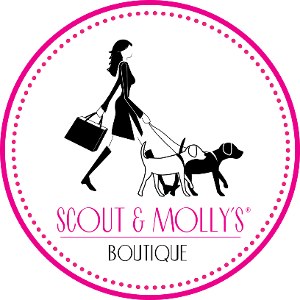
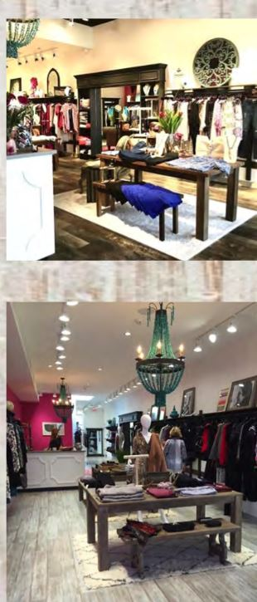
Semi-Absentee Model – (Manage the Manager/ Develop multiple locations)
Work flexibility
Retail Analysts help owners run the business by the number
Concierge type service and individualized client styling ( personalized shopping)
  Retail and Trunk Shows
Ongoing Field Support
Perfect Business for NY - Boutique clothing in a fashion market
Strong Marketing support
Each location will have an area of protection of a minimum 3-mile radius

Slide 5
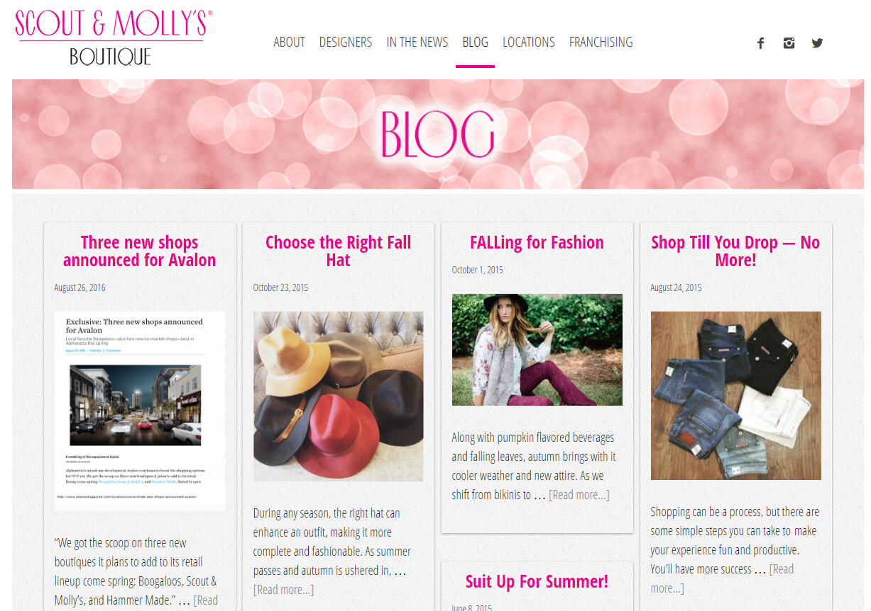

Slide 6
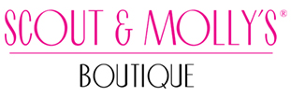
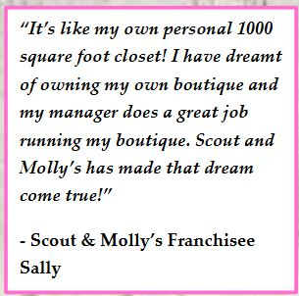
What are other people saying about it?

Slide 7
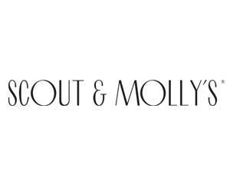
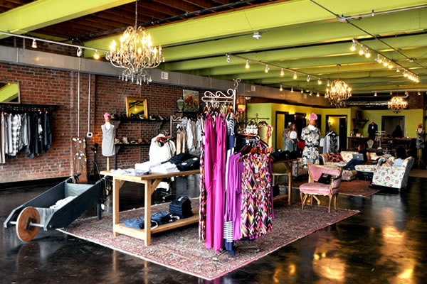
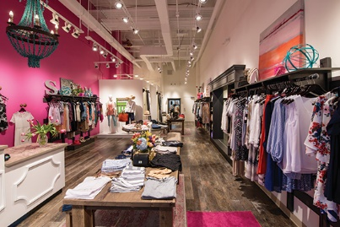

Slide 8
According to Business Insider, the women’s clothing industry is a $750 Billion industry.
Investment averages $300,000 including working capital
Fun & Simple business model!
“Rustic Chic” shopping experience
Scout and Molly’s is a storefront business catering to women of mid to high income households. Average customer is 25-65 year old female but Scout & Molly’s does a good job selling to husbands or boyfriends too.
The targeted Scout and Molly’s customer is a woman who wants to feel good about herself and sees clothing as a way to reflect that.
Item 19 in the FDD shows $275,000 Net Income

Slide 9
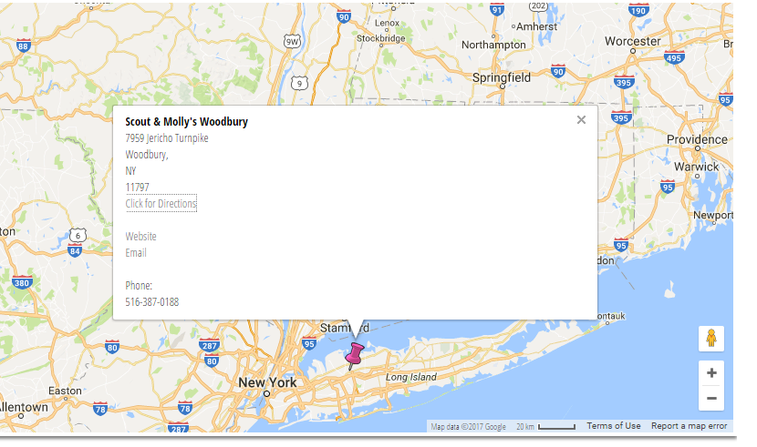

Slide 10
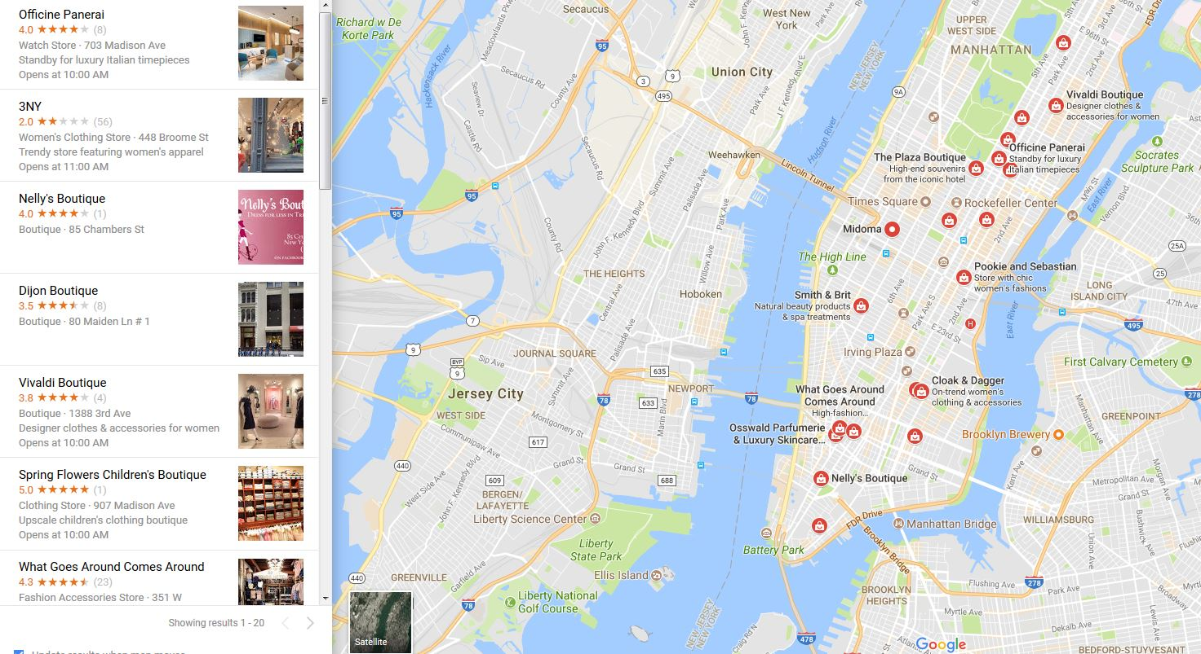

Slide 11
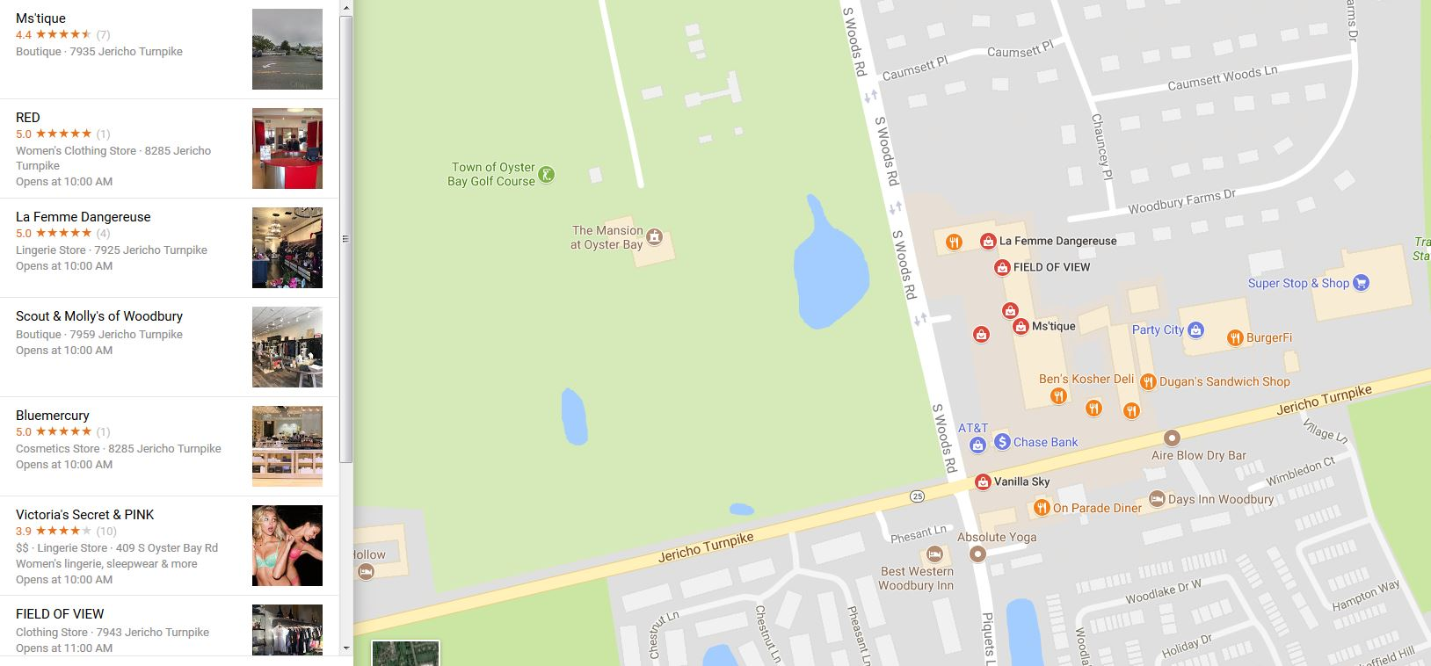

Slide 12
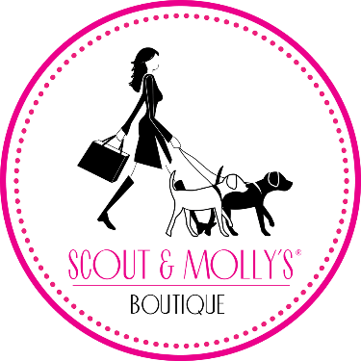
Scout & Molly’s Boutiques are beautiful. People shop where they are made to feel comfortable and important as a guest. Scout & Molly’s customers are loyal and our associates act as a personal fashion stylist for them.
How?
Sales Rx Prescription – Sales training program for owners and managers
Retail Analysts help owners run the business by the numbers
Brilliant Buyer Program – helping zee in the buying process
Concierge type service and individualized client styling (personalized shopping)
Unique Marketing

Slide 13


  Nationally recognized brand – 80% Retention Rate of Franchisees
  Membership Based Business Model
  Blow Dry Bars are a thriving industry disrupting the salon Business.
  The style looks simple, but can be difficult, time-consuming and physically tricky
  To achieve at home.
  Recurring Monthly Revenue
  Ability for Multi-Unit Ownership and it allows for a semi-absentee owner model.
  They have been a franchise business for 9 years, established in 2008.

Slide 14
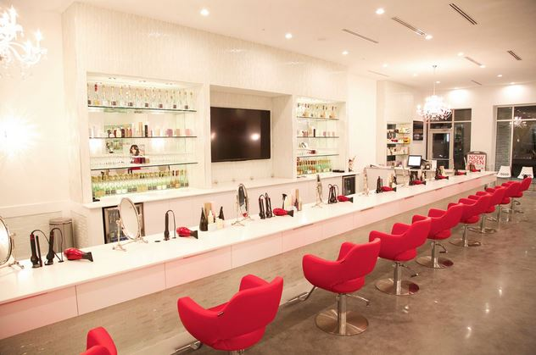

Slide 15
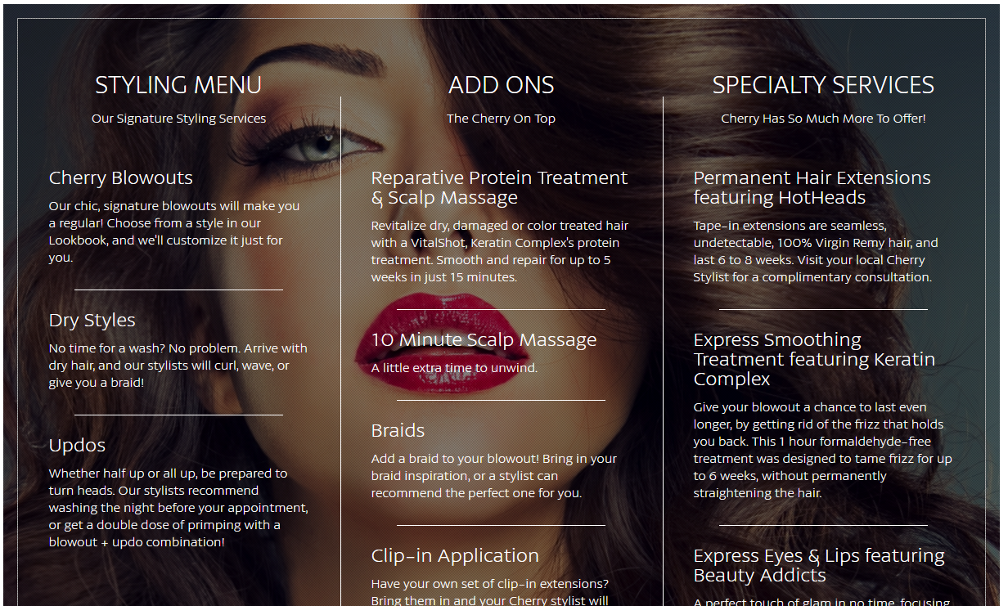
  Services
    Hair
    Treatments
    Make-up
    Travel to location
    Parties

Slide 16

  Co-Op Advertising support
  Regional Media
  National Media Support
  State of the Art furniture and overall floorplan appearance
  Cherry is a membership based concept with an average salon having 800 to 1000 members paying an average of $80 per month for their membership
  Members are receiving world-class styles 2 & 3 times per week.
  This concept is not for the occasional night out – it serves the professional business woman who is always needing to look and feel her best.
  Investment Range - $220,600 - $395,000

Slide 17
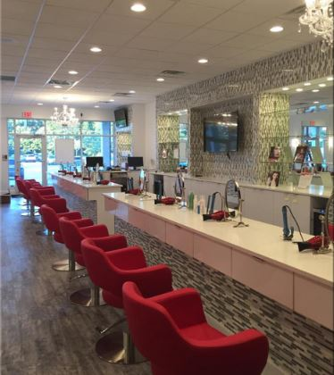
The owners of Cherry Blow Dry Bar are also master / area developers with Hand & Stone --- they have sold all 40 units they have available within their territory of NJ and have been consistently among the strongest region for the entire Hand & Stone Chain.
They have taken what they learned over the past 12 years at Hand & Stone regarding the membership model perfected it and now it has become the Cherry Blow Dry Model as well.
Total Investment: $218,600 – $392,500 (dependent on the size and condition of the location to be transformed into your Cherry Blow Dry Bar)

Slide 18
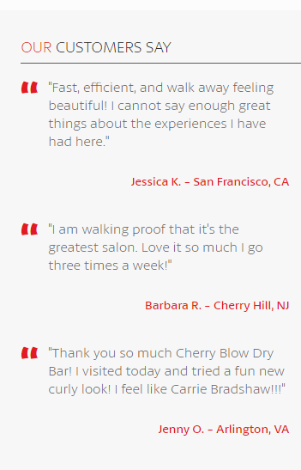
1500 Sq Ft
1200 being the lowest
1 locations can handle up to 2000 memberships per month and 10 chairs.
Monthly membership charges range from $59.99 to $125 depending on the level of services purchased
Members can visit 2-3 times a week (Restricted Membership)
Easy to hire, less restrictive licensing

Slide 19
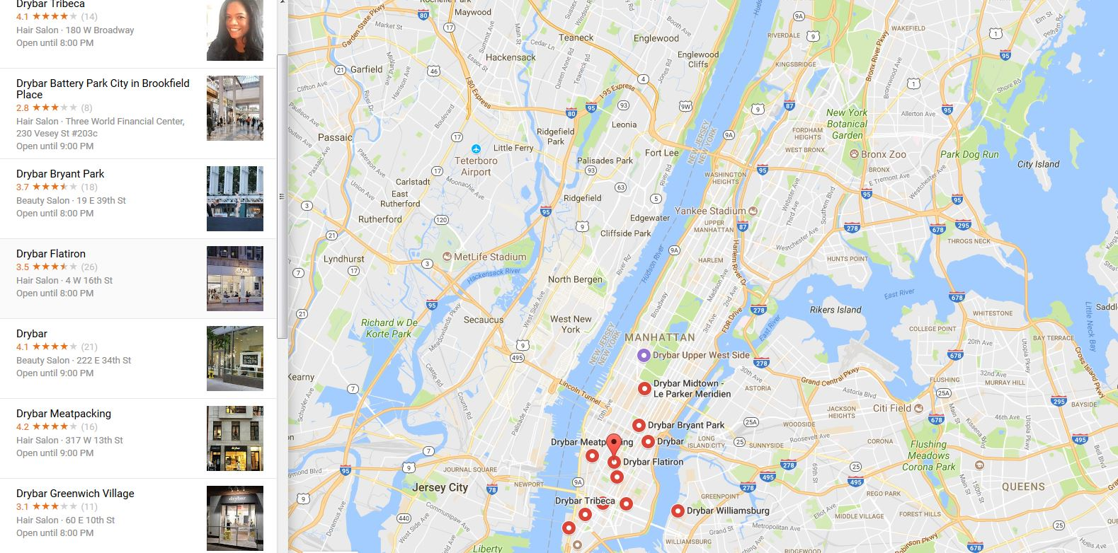

Slide 20

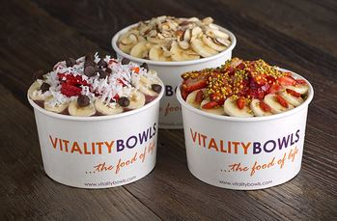
Established brand – 93.75% franchisee retention rate.
Owner is required to be in Business full-time for the first 3 months, but then it can be run semi-absentee.
Established in 2011 with 23 locations
Multi unit options available
Protected territory is available
Franchises are typically placed near schools, gyms, offices and residential

Slide 21
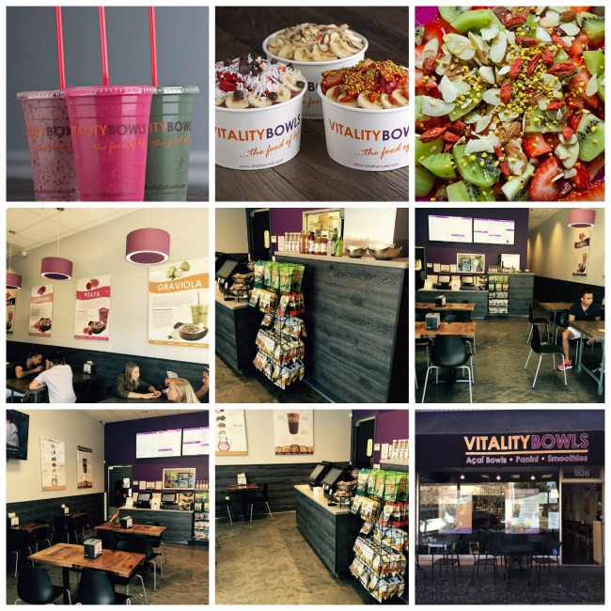

Slide 22
This a great role for an owner that wants to make a difference in the community and mentor young adults.
High quality products that are easy to make and owner can operate without putting in tremendous hours
High Growth Industry with demand from a large range or customer profiles
Fantastic performing corporate stores with strong profit margins
A brand and products you can stand behind
A great role for an owner that wants to make a difference in the community and mentor young adults

Slide 23
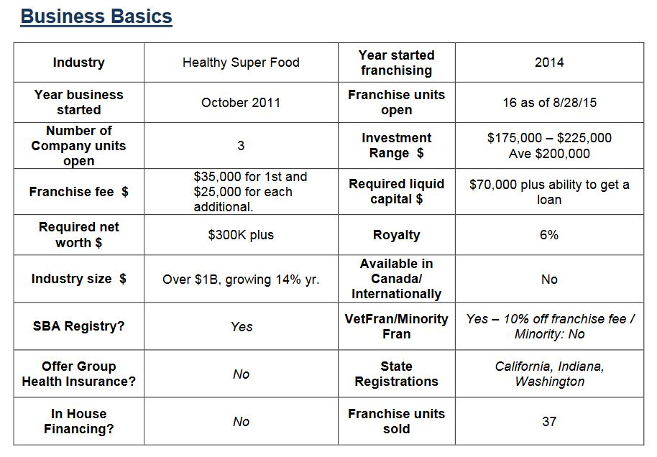

Slide 24
Vitality Bowls continues to create new and exciting Acai Bowls, smoothies, juices, soups, salads and Panini. All our products meet our strict quality and nutrition guidelines.
0g trans-fat, no artificial flavors, no fillers, no ice, no added sugar and no artificial preservatives. We source locally and seasonally organic whenever possible.

Slide 25
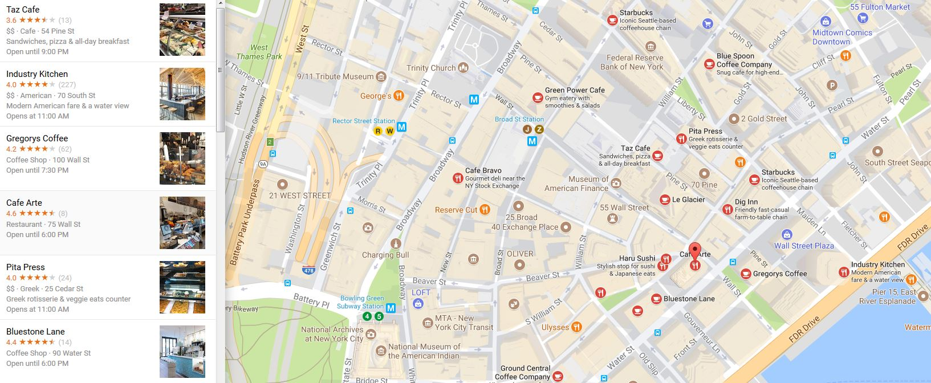

Slide 26
Rating of the Franchises
& Questions?

