Slide 1
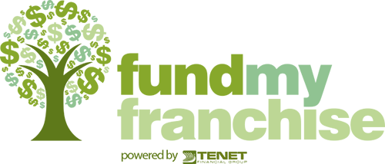
Funding Q & A
Al Lesko- Fund My Franchise

Slide 2
Al Lesko- Owner Fund My Franchise
Our experienced team of professionals knows the franchise industry. We consult with your clients to adequately fund their business of choice. Whether they choose Equity Funding, using our tax and penalty free Self-Directed 401(k), plan to capitalize a business wholly or partially, or traditional Debt Funding, utilizing unsecured lines of credit or Small Business Administration (SBA) Loans, we are here to help clients realize their entrepreneurial dream.
Notes:
With my 10 years of experience as a top producing Franchise consultant, National Franchise Trainer, Franchise Development and Funding I know what consultants, franchises and the clients need to navigate through the funding challenges.
Clients need a true consultation and not a sales pitch! It is expert advice in addition to having an accurate understanding of what are the best options that they seek.
They need to know how important it is to properly capitalized so they have the best chance at early as well as continued success. They need to know why it is important to establish business credit lines as soon as they open.
Simply said this is what your clients can expect from a consult with FMF.

Slide 3

Why should you suggest that a client discuss their options with a funding specialist?
What’s in it for you?
Notes:
This is simple. If your client is well informed and knows their funding options well then their focus will be on the franchise opportunities you are presenting, validating with franchisees, working through the process with the franchisor, and making a decision.
It is a starting point for you and your client to know what they can afford and the process that is required to successfully be funded. The banks will have different requirements unique to the project, the amount of funding needed, the clients experience & financial profile. In fact each bank has specific policies, procedures, and preferences.
What is in it for you?
The key to closing more deals and closing them sooner is early on funding education and preparation. I have had too many franchises, clients, and franchise consultants tell me about how funding either held up the close, prevented a close, or created unnecessary stress.
Having your client start the funding process sooner will save you research time and have them realize what is within their capabilities, comfort range, and the cost of money to borrow. Also it will open their eyes to the possibility of more than they may have realized they could afford and perhaps a multi unit deal for you. If you consistently bring highly qualified and well prepared clients to the franchises you will receive preferential treatment, earn their respect, and possibly some long term opportunities with their company. Examples of possible opportunities are brand representation, leads, incentives, paid expenses for discovery days, perhaps some money toward lead generation for their brands. Franchises want to work with the best consultants and seek them out.

Slide 4

Why do franchise brokers and franchisors need to be educated about funding?
Notes:
What you don’t know can and will hurt you!
The more educated you are about banks, SBA programs, using unsecured lines of credit and the differences between them, 401k/IRA benefits (short and long-term exit strategies) the easier it will be to gain a clients trust and loyalty.
The more loyalty and trust = more deals closed, increase in multi-unit deals and more referrals in the future from your clients.
Sadly not all funding sources and their representatives are honest, or properly trained, are willing to go the extra mile to get a deal done, are creative enough to find a way to get your client across the finish line. Simply put there are a lot of inexperienced employees at funding sources that are only interested in selling a product, and only interested in an easy deal that they make a commission on! That includes large and small firms, well known and not so well known. This is not an opinion it is a fact! We hear from dissatisfied clients, brokers and franchises about poor customer service or follow up.
Many times we have been able to save deals gone bad and for certain put some of the ones we can’t on the right path to qualify in the future. That in of itself is something to think about. You are in the business long term so why not prepare a client that did not qualify today but could in the future. If you work with a funding partner that subscribes to this belief and is willing to advise your clients properly then who do you think they are going to call if and when they improve their financials? How many deals over the life of your career could you close as a result of partnering with the right source and educating yourself on the funding qualification terms?

Slide 5

How involved in the process should you be?
How involved in the process should a Franchise Representative be?
Notes:
We understand some consultants and franchises want no part in the funding process. We know some consultants and franchises are uncomfortable discussing financials. We feel franchise consultants should be involved in the funding process from start to finish and working closely with your funding partner.
You are the project manager and you client is working with you and in fact counting on you to help them through a complicated process (Franchise research, validations, competition, demographic studies, lifestyle requirements, income expectations, ROI, funding options, and putting it all together). Why would you leave your client on his/her own to learn on the fly about the do’s and don’ts of funding a business and the proper companies to do business with?
Did you know some franchises are referring your clients to funding sources (and who knows who at them) they have agreements with? You have no idea who your clients are talking to or about? You could be losing revenue for Rollovers or opportunities for multi unit purchases. Note to consultants, Banks are not franchise experts! They know very little about your process or the terms of a franchise offering! Banks are the decision makers if a person meets SBA criteria. They all have preferences and prejudices toward certain franchises, industries, and specific terms to fund!
As for the 2nd slide question it is our belief a referral from a consultant is to be left in the hands of the consultant. The client is your client until they close and not theirs to do as they please. I have heard and witnessed 1st hand a rep steer a consultant’s client toward their funding source on a presentation call which is another reason consultants should always be on the initial call with a franchise rep and their client. It is an unethical practice for a franchise or franchise representative to do this. I assure you it will cost you clients over time and certainly money. It is also an unethical manner of steering your client toward their brand in spite of the other options they may be pursuing with you.

Slide 6
When should you discuss financials with your client?
FMF suggests a subtle approach.
Notes:
FMF suggest you do so on the very 1st call. This is more than an opinion but rather a best practice utilized with the best of the best consultants and franchises in the industry. I myself do and will not consider moving forward with any brand research or putting a client in front of a franchise until I know their financials.
Note having a client complete a CQ or an application to obtain financials is not the same as asking a client to disclose pertinent information that must be disclosed to you and a franchise to start the process. That only leads to more questions and more inquiry calls. It also does not help you determine if you have a viable client.
It is difficult and inconvenient for you to ask your client to participate in multiple calls to get information that could be obtained on the very 1st call. This is especially true for busy people, CEO types, and people who like to be productive with their time. Time kills deals, we all run out of time, we want to close more deals, strive to be efficient so then why waste an opportunity?
After an introduction of each other and some exchange of reasoning for the client’s interest in considering a business investment, their time line, and areas of interest the one suggestion to ask if the client has given any thought to how they intend to fund the business? Are you planning on self funding or have you looked into any options? What is your comfort range to either self fund or borrow to fund? Are you familiar with all of the funding options available to investors? If so, are you aware of what the qualification terms are? Have you run your full credit report recently? Would you like me to introduce you to our funding expert? He/she offer a free consult for our clients and I assure you they won’t try to sell you anything or pressure you in any way

Slide 7
About Fund My Franchise:
What is the advantage of introducing a full-service funding specialist to your client?
Why are third party handoffs not a good idea?
Prepare your client for the funding consult. What will they need?
Notes:
What is the advantage of introducing a full-service funding specialist to your client?
Answer.
Having a full-service funding specialist makes you look good as the project manager and build trust and confidence in you by your client. Having a full service funding specialist with experience with each option (more than just knowing the sale price) and how each of them are constructed, terms, pro’s, cons’ and costs is an asset to your clients and will shorten the decision process in the sales cycle. Working with the right banks, with direct relationships with the decision makers will minimizes roadblocks and will result in a quicker close. Your client will appreciate the customer service and not be just a number to the bank or funding institution.
Why are third party handoffs not a good idea?
Answer.
You are not in control or in the know of anything happening with your client. Your client could be talking to a multitude of people, some of these people are just pushing paper and processing, they are not and nor do they have the desire to get to know your client or will lose any sleep if you don’t get the deal. Employees are not business owners, some care and are passionate about what they do and some are not. Do you really want to chance that with your client? How can you follow up if you don’t know? Am I saying call the banks? No that is your funding specialist responsibility. Harassing or over-extending yourself can cost your client an approval as well. Bottom Line is by not doing so your remain in the loop, in control, prepared to assist if asked, and maintain a high level of customer service for your clients.
Prepare your client for the funding consult. What will they need?
Answer.
Your client should know the funding source will want to know about them, their goals, their timeline, and the franchise(s) or business of interest. They should be prepared to discuss their most recent full credit report and what the role is of the funding expert. We are evaluating and helping them prepare to apply for the funding option of choice and educating them on their options. We will be looking for potential problems and suggesting solutions before the attempt to apply for a loan. We are a source of education, and a strategist to help them get properly funded.

Slide 8
General Funding Questions
What are the five factors of a FICO score?
What defines a hard pull and a soft pull inquiry?
How do recent big purchases affect the loan application and approval?
Is a personal or business bankruptcy an automatic disqualifier for an SBA loan?
Why is allowing your client or the franchisor to shop a loan application a bad idea?
Notes:
5 Factors that are used to calculate a FICO Score are as follows: Payment History, Amount Owed, Credit History, Types of Credit, New Credit. See the next slide for more detailed explanation.
What is a soft inquiry?
A soft inquiry is an inquiry that occurs when a person or company checks your credit report as a background check, like when you check your credit score or a mortgage lender preapproves you for a loan. Soft inquiries can occur without your permission, but don’t worry – they won’t affect your credit in any way. Source U.S.NEWS. https://creditcards.usnews.com/articles/the-difference-between-hard-and-soft-credit-inquiries, Jenna Lee, Contributor |July 24, 2014, at 8:40 a.m.
What is a hard inquiry?
A hard inquiry is an inquiry that occurs when a prospective lender checks your credit report to make a lending decision. Hard inquiries can slightly lower your credit score and will typically stay on your report for two years. Source U.S.NEWS. https://creditcards.usnews.com/articles/the-difference-between-hard-and-soft-credit-inquiries, Jenna Lee, Contributor |July 24, 2014, at 8:40 a.m.
Note some sources will tell you that hard pulls won’t affect your credit scores much. That is not true for SBA, Unsecured or even private lending sources. It matters and more that 2 or 3 in the last 6 months will for sure have an impact.
How do recent big purchases affect the loan application and approval?
Recent large purchases will affect all 5 aspects of the FICO scoring. Most notably Amount Owed, New Credit. It also effects the amount of debt relative to the household income and the borrowers ability to pay as well as if they could afford to take on more debt.
Is a personal or business bankruptcy an automatic disqualifier for an SBA loan?
Not necessarily! If the bankruptcy is old (over 7 years prior), client has a good payment history since, good income, more than one income helps the cause and a good reason of why the bankruptcy occurred (medical, sometimes divorce) a bank can fund. It certainly will be seen by the bank at pre-underwriting (hard pull inquiry) so it is important a client share this with you and your funding source. Again our relationships with the decision makers at the banks that fund the loan matter. In this example we can help lobby for your client. It does carry an impact.
Why is allowing your client or the franchisor to shop a loan application a bad idea?
Creates multiple inquiries, confusion, bank suspicion, frustration, and the qualifiers are the same, without a relationship with the decision maker at the bank your client is at a disadvantage. It is a MYTH that banks are competing for every clients loan application. It actually can cause your client to be rejected when they should and would have qualified by using one funding source that discusses your clients needs prior to applying for a loan. Shoppers can’t do that and therefore create havoc. I know of consultants and franchises that do this and they are not helping and in fact hurting the clients chances. STOP DOING THAT! I personally will not work with consultants, clients, or franchises that do this. It is a waste of my time, theirs, the clients, and they always point the finger at me and the bank. So please do not ask me to participate if you insist on doing this.

Slide 9
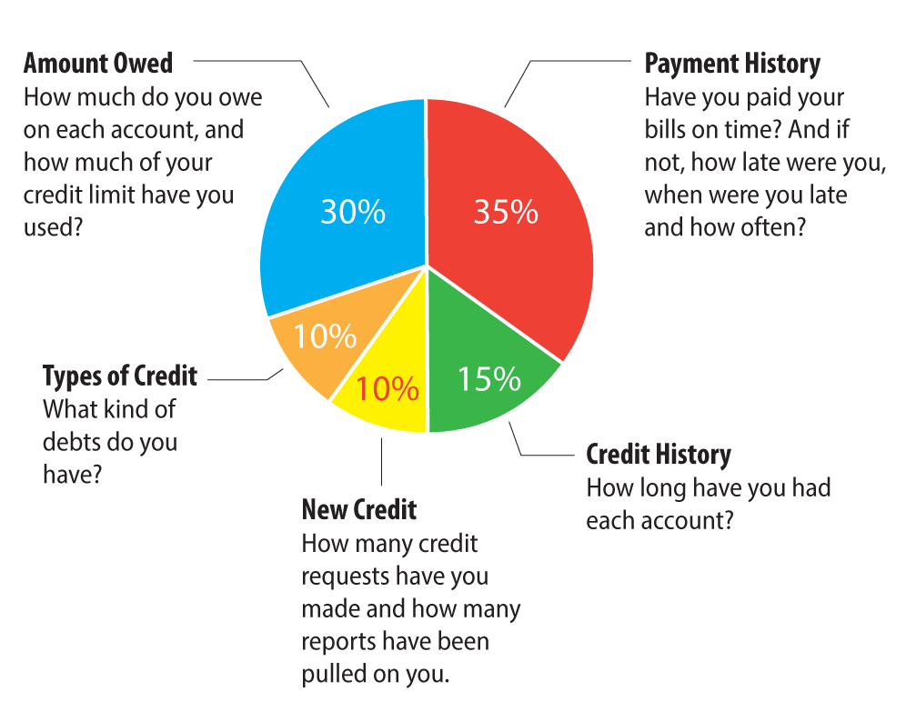

Slide 10
Frequently Asked Questions:
What information will the banks use to determine a person’s credit worthiness?
Can multiple combinations of funding options be used to properly capitalize a client? Is timing a factor?
What is an in-service distribution clause?
Can a trust fund be used as a cash injection on an SBA loan?
Are there funding options for E2 visa or international clients available?
Notes:
What information will the banks use to determine a person’s credit worthiness?
FICO criteria and their own internal policies.
Can multiple combinations of funding options be used to properly capitalize a client? Is timing a factor?
SBA/401K/IRA/Cash/Stocks and Bonds can be used and at the same time. In fact it is the rule as opposed to the exception. SBA and unsecured can’t be but you can and should get a business line of credit once the SBA has been funded and the client is open for business. SBA will not except a HELOC (Home Equity Line of Credit) as the required cash injection.
What is an in-service distribution clause?
“An in-service distribution allows you to rollover your vested balance from your profit-sharing plan to an IRA. You will have to determine first if you are eligible. ... With an IRA, you are the account owner and have more control over your assets, free from the restrictions your employer-sponsored plan can impose. “Good Financial Cents, https://www.goodfinancialcents.com/in-service-distribution-401k-rollover-while-still-working/ By Jeff Rose May 18, 2018.
There is an IRS allowance and some employer retirement plans have a provision that allow employees to defer funds from their company sponsored plan into another qualified IRA or 401k plan while they are still employed. This is what we set up for clients. We don’t see this in the majority of employers plans but we are starting to see it more frequently. This means your client can self direct funds into a plan and invest in a business as part of the 401k portfolio.
Can a trust fund be used as a cash injection on an SBA loan?
It depends on the terms of the trust fund. In some cases it is eligible, and the bank will require an authorized signature of an officer, and trust fund recipient to allow for it. This is necessary to ensure the funds are available if being used to secure a loan. In other words if used as a reserve amount the bank is granted a waiver to make claim/collect on it if a person defaults.
Are there funding options for E2 visa or international clients available?
If a client owns property in the U.S. has a credit history, then private lending and unsecured lines of credit are possible. Canadian clients are eligible for some Canadian government loans. It is also easier for Canadians that own property in the US to obtain capital from private US lenders. None are eligible for SBA loans. However they can partner with US Citizens on private loans from US banks and the SBA will consider applicants for the US citizens portion of the loans.

Slide 11
401(K) Funding
What are the benefits for a client using their 401(K) plan to fund a new business?
Clients invest some portion of their retirement funds into the business, giving them more control over the performance of their retirement plan assets.
Use a safe, proven plan, based on long/standing provisions of the Internal Revenue code
Gain business equity and an improved cash flow position from the start
Accelerate business profitability by managing the amount of debt the new business takes on
Secure funding fast-typically 3-4 weeks or less
Set aside tax deductible retirement savings up to $62,000* per year
Optimize business equity and value
* For those over age 50. For those 49 years and younger the contribution limit is $56,000. This amount adjusts annually.

Slide 12
Unsecured Lines of Credit
What is the advantage of having an unsecured business line of credit?
No profit needed
No Revenues
No Down Payment
No Collateral
Obtain unsecured lines of credit as soon as 10-14 business days
Notes:
Probably the most overlooked funding opportunity for franchise and Franchise consultant clients, franchisees, and business owners.
Best to call our offices to learn more about this opportunities and where it is best utilized. Or review the resource section on our website www.fundmyfranchise.com
There is a lot to learn, especially why a client should not try and apply on their own. What the differences are between personal and business and how each affect a person’s credit or not. Competitors of ours are touting huge LOC for clients but they are misleading and dangerous. Most often they can’t deliver on the claims. Don’t do it! It could cost you a client and a long-term referral. Vending companies are notorious for referring their clients to some of these companies. While it can be effective and a good option it depends on whether it is business or personal or a combination. Remember you can’t apply for a business line of credit without a Tax ID number being part of the equation.
Why Credit Card Financing?
Lifetime Availability
Once the credit line is established, as long as you maintain good standing with the lender, that line of credit is available to you for the lifetime of your business.
Revolving
Every time you pay down the debt , you are able to use that line of credit over and over again.
Cash Flow Friendly
You have the ability to make minimum payment amounts in the months your cash flow is low.
Establishes Business Credit
Start Up’s and established companies with no business credit rely on collateral and cash to get the funding they need. If you establish business credit early on it will help leverage different borrowing products in the future and you don’t have to risk your assets and cash
0% Introductory Rates
It is possible to 0% for 12 months on business lines and 0% on Balance Transfers
Common Objections to Credit Card Financing
I need cash!!
Cash Advance/Balance Transfer Options
Credit cards allow you to pay for other items and preserve your cash
LenCred/Fund My Franchise partnership has a few other tricks for its customers to solve this objection!
My credit score will drop
Maybe – in many cases we have seen it go up because your utilization goes down with the addition of more credit lines.
55 Point rule: The average credit score ranges from 850-300 – that is a 550 point spread. Inquiries only effect 10% of your total credit score, so the average credit point drop is 55 points. Any large debt taken on will affect your credit score.
If you spend the money wisely and pay on time, you will build your credit worthiness and your score will rise as you pay down debt. The debt taken on to start/grow a business should be paid off through the business as a monthly expense and soon as reasonably possible to take advantage of 0% financing introductory rates and to avoid interest.
If you have a client that you think could qualify, they will need
A valid driver’s license
A utility bill to verify address
Copy of their EIN Certificate
Copy of their Articles of Incorporation
A way to verify income (some lenders will ask)
To contact Al Lesko of Fund My Franchise!

Slide 13

SBA Funding
Partnerships. Partners are required to be on an SBA loan if their % of ownership is?
How much money is required to cash inject into a typical SBA Express and and SBA 7A?
What algorithm is used to determine the SBA repayment interest rate?

Slide 14
SBA Express Loan Requirements:
SBA 7A Loan Requirements:
680+ FICO score for all primary business owners.
Down payment of 10% or more if using loan proceeds to purchase a business or commercial real estate.
Collateral: SBA loans do not need to be 100% collateralized. BUT the more business and/or personal collateral clients bring to the table, the easier it is to get the loan approved.
SBA Express loans can be collateralized by the business itself with as little as 10% personal cash injection.
2+ years in business: Startups can get SBA 7A loans but it is more difficult. If client wants to try for an SBA loan as a startup, they need to have all of the above plus business management and industry experience.
Business is profitable.
No delinquencies or defaults on debt obligations to the U.S. government (including student loans)
Commercial real estate loans must be 51% + owner-occupied.
Be a small business as defined by the SBA (generally under 500 employees or less than $7.5 million in annual sales).
Be engaged in a industry that is eligible (most non-vice, non-speculative businesses are).
Be a for- profit business engaged in, or planning to do business in, the United States or its possessions.
Use alternative financial resources, including personal assets, before seeking financial assistance.
Be able to demonstrate a need for the loan proceeds that also qualifies as a sound business purpose.
You are required to create or retain jos and meet public policy goals that are in line with the SBA goals.

Slide 15
Thank You!
Contact us:
Fund My Franchise
www.fundmyfranchise.com
contact@fundmyfranchise.com
541.831.0071

