Slide 1

Franchise Consulting & Funding Module 1
The basic principles of what you need to know
Alicyn Taft & Al Lesko

Slide 2
1st opportunity to qualify
Once you have a client that is genuinely motivated to start a business your 1st step should be to evaluate how much financial resources they have as well as their knowledge of their financial profile.
Elements of a Financial Profile for the purpose of obtaining a loan:
Income vs Debt
Savings., Liquid Assets (cash, stocks & bonds, IRA, 401K)
Assets that can be collateralized (Homes, rental property)
Secured Debt, Unsecured Debt (How much is secured to an asset like a home, car, boat, motorhome vs the amount of unsecured like credit cards or a personal loan).
Longevity of Credit History ( Lenders need to see 5 years of credit history)
Depth of Credit history (Lenders need to see multiple credit lines. Student Loans, Car loans, Mortgage, Credit Card are examples)
New Credit History ( What and how much credit has been applied for in the last year to 2 years) Hard Pull inquires
Payment History ( Does the client pay on time? Is there a pattern of late payments? How many late payments? How long were they late?, How recent?, Is there a pattern).
Note The best way to get a peek in the window to a persons Financial Profile is to simply ask a few questions a prospect should be prepared and comfortable in answering. It is your 1st clue to see if your client is serious and how soon they may be willing to move forward.

Slide 3
Non-Threatening Qualifying Questions
Setting up the prospect to get the financial information you need.
I think its great that you have an interest in starting your own business, I am curious as to what has motivated you to do so?
What is your investment comfort level? May I ask how much you have saved up for this project? This will help me determine your limits and what opportunities are available to fit your budget.
Are you going to be the only investor, or will you have a partner or family member involved? If so, what will be their involvement and financial commitment?
Have you considered a loan to fund the project? If so, are you familiar with some of the options available for starting a business or purchasing and existing business?
Are you aware of the qualifying factors to obtain a loan? Are you aware that your non employer 401K/IRA can be used for a business investment without incurring a tax penalty?
Do you review your credit report monthly? The reason I ask is because if a loan is going to be part of your financial strategy you will need to ensure you know the lenders qualification factors to know how much you may qualify for and to increase your chances of being approved.
I would like to offer you the opportunity to speak with our funding strategist at your earliest convenience and honestly it is imperative we have an idea of how much of an investment is within your reach so that I can start preparing some opportunities to consider within your areas of interest.
Our funding strategist is not a salesperson but rather an expert in funding strategies and providing funding options for you to consider. There is no obligation at all, but I can assure you it will be educational and a valuable resource for you should you decide to move forward.
In order to have a more productive call with our funding strategist it would be extremely helpful for you to provide a complete credit report to (her/him) prior to the call. We offer a free credit report that is a soft pull and will not affect your credit score. Click Here so our financial partners are then able to review your report and provide us with their assessment.

Slide 4
Example: Financial Profile
We will review the two examples. One is a complete credit report, and the other is a summary of what was discussed in the prior slides.
Goal is to understand a credit report is more than just a score in the eyes of a lending institution in determining if a client is qualified and for how much.
Factors to pay attention to
Income vs Debt
Utilization ratios of both secured and unsecured debt
Unsecured Debt
Longevity and Depth
Late payments
Recent inquiries, the number of them and the purpose of the inquiry

Slide 5
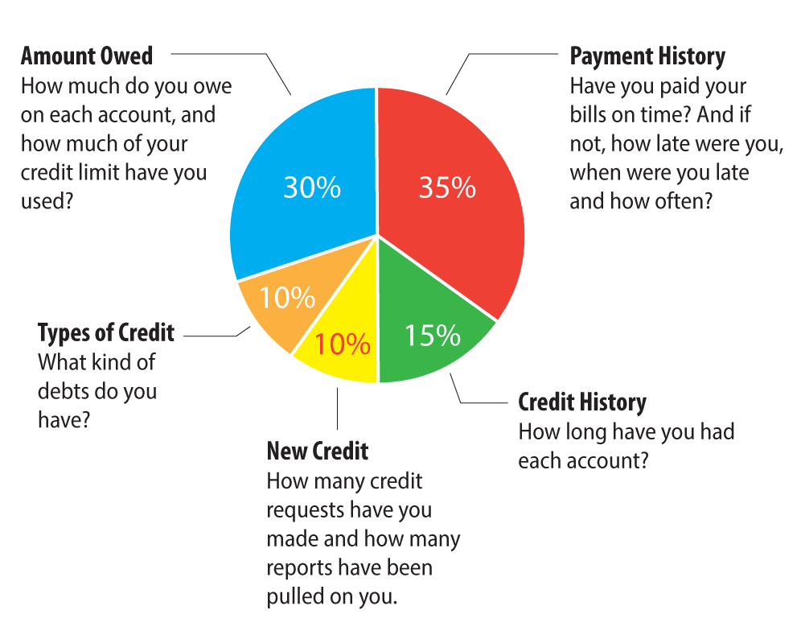

Slide 6
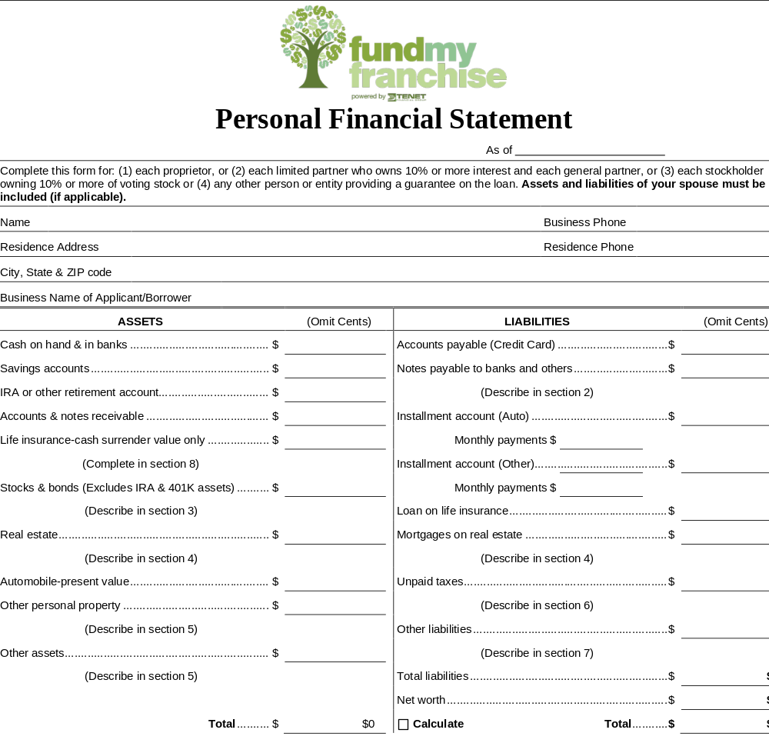

Slide 7
The Qualified Prospect Profile
Has good credit (trust and verify) Ask questions, apply knowledge, refer to Funding Strategist
Has available liquidity ( cash, stocks & bonds, IRA/401K, ) For minimum SBA loan of 50k needs roughly 10k cash and 50k in reserve
Has income
Has a good debt to income ratio ( has enough income to pay the bills, can carry a loan payment, with funds left over)
Has 5 years credit history and depth.
Is not over-extended on credit cards (all credit cards carry less than 35% or less debt to credit limit)
Is a US Citizen or Green card holder.
Less than 1 or two late payments especially in the last 5 years. Especially nothing recent and any others resolved not settled for less.

Slide 8
Questions

