Slide 1


2023 FTI Funding Training
Funding tips and tools you will use in your day-to-day consulting practice

Slide 2
Overview
Very simple: By asking and obtaining the right information at the right time will help you save a deal, close more deals, and close them quicker.
To accomplish this goal, you may need to develop a successful process.
You must understand the financial environment is always subject to ever changing conditions, what impacts these changes, what information is available, how to present the information, and information you need to obtain from them.
If you don’t prepare your clients properly then to paraphrase a Bon Jovi song your only half-way there, oh you’re living on a prayer. That is not a winning strategy for 2023

Slide 3
Questions we will cover
Why are seemingly good deals lost?
Why are SBA applications rejected by banks after a pre-qual? Is a pre-qual of any value?
My role as a broker in this part of the process? What is the franchise role?
What are my informational tools and how to present them to clients?
Timing is everything, why is that?
Types of funding. What do I need to know?
What are the new changes with lending SBA, IRA/401k rollovers, personal loan?
Rising interest rates and how to minimize a client’s concerns. Quick tip to ease your client’s concerns.
Economic conditions will dictate what funding sources people will need to consider
Tricks of the trade to use funding to move the deal to close sooner.
Debt-to-income
Monthly payments
$3,321.00
÷
Monthly income
$8,100.00
=
Debt-to-income Ratio 41%
Reducing your monthly payments by $424 will put your ratio at 35% (what lenders prefer).

Slide 4
Funding options for Franchise Investing
SBA Loans (Express Loan & SBA 7A)
IRA/401K Rollover (Not held with a current employer)
Personal Loans (Must have Documented Income)
Business loans (Must be in Business 2 years with Good Returns)
HELOC (Home Equity Line of Credit)
FFF (Friends, Family, Fools)
Self Funded (Should someone do this? Let’s discuss it)

Slide 5
SBA Loans
SBA Express
Complete Credit Report & Score of 680 or better.
25K total must use 11.1% cash to inject into the business and the remainder is the reserve liquidity. (Cash, Stocks & Bonds, IRA/401K)
SBA backs the loan 50%
Debt to Income ratio
Total Household Income
Assets (Liquidity) too much or too little can be a disqualifier
5 years of Credit Longevity & Depth in credit history
Payment history of the applicant
Any Derogatory issue on the clients
Generally, for Start ups (no build outs).
Resume (Managerial Experience)
Personal Financial Statement
3 years Tax Returns (Biz & Personal)
2 years of Projections (pro-forma) Bank Provides Template in most cases. Simple Business plan on bank template
No Felony convictions or Judgements in applicant’s history
Entity documentation, Articles of Information must match application and the industry on the loan application. Also, FDD & Agreement
SBA 7A
Complete Credit Report & Score of 680 or better.
Generally, 20% cash injected in the business, 20% in liquid reserves. Some Industries require less.
SBA backs the loan up to 90%
Debt to Income ratio
Total Household Income
Assets (Liquidity) too much or too little can be a disqualifier
5 years of Credit Longevity & Depth in credit history
Payment history of the applicant
Any Derogatory issues with the client
Used for Resales, Start ups, Expansions, and build outs
Resume (Managerial Experience)
Personal Financial Statement
3 years Tax Returns (Biz & Personal)
3 years of Projections (pro-forma), client must produce & Solid Business Plan including franchise history, vision, specific detail for their territory demographics
No Felony convictions or Judgements in applicant’s history
Entity documentation, Articles of Information must match application and the industry on the loan application. Also, the FDD and Agreement

Slide 6

There is no standard Modus operandi
There is no set standard for banks or the SBA. Only minimum qualification terms
SBA rules can and so change often. Bank policies change often.
Special SBA incentives happen (we have this going on right now).
Banks are the ultimate decision maker on granting the loan.
Banks worry about their lending status with the SBA. The banks portfolio of loans performance is a determining factor for the bank to be allowed to fund SBA loans directly.
Supply and demand dictates changes for the bank and SBA. 2023 Banks are looking at depth and history more closely.
The Federal Reserve plays a huge role in the interest rate.
What funded last week by X terms may not apply tomorrow to the exact X terms.

Slide 7

Importance of Validation for SBA Loans
Applicants will be required to submit 2 years of projections for SBA Express loans and 3 Years of projections for SBA 7A Loans.
Applicants will need to submit a business plan for an SBA 7A loan and some banks are now requiring this for Express loans.
Applicants need to base both the projections and the business plan on factual data. They must coincide with each other.
It will help a client realize the effort needed to reach their income expectations and when, what the business can achieve, and what they can sell it for.
Because it is a CYA for you!

Slide 8
SBA Loans 2023
Why are SBA loans more important than ever for small businesses?
1. Approval rates - Recent bank collapses alongside another increase in interest rates continues to shift the industry to increasingly stringent lending standards. With higher credit requirements, fewer businesses will qualify to obtain a loan in the full requested amount. As lenders slow their loan approval rates, small businesses may need to wait longer to receive any loan amounts for which they receive approval.
2. Credit Cards Average 20% interest - Credit card interest rates have reached an average of 20%. Since most credit cards have a variable interest rate, yesterday’s rate increase directly impacts credit card interest rates. 20% rates reflect an all-time high from March 2022, when the rates hovered at 16.25%. For small businesses that have relied upon credit cards, the interest rate on the cards creates an even larger challenge for businesses that struggle with cash flow.
3. Inflation Challenges - The Fed’s recent decision to raise interest rates is an indication inflation is still a major factor with which to contend. Keeping business growth in pace with the rate of inflation has been exceptionally difficult. Owners would need to grow business profits by 6.0% annually to match inflation rates. For those whose businesses have not grown as rapidly, owners are left to cover the additional cost of goods.

Slide 9
IRA/401K Rollover
Let’s keep it simple what is it?
Simply put in layman's terms it is the diversification of a retirement account that allows an individual to not only invest in stocks, bonds, mutual funds, gold, silver, or real estate but also into a business they own without incurring a tax penalty.
The process involves the creation of a qualified plan & setting up a C-CORP. This must be created by a Certified and 3rd party administrator, and the plan approved by the IRS. This plan must be managed by a 3rd party who is responsible for periodic testing for compliance and up to date with any tax laws that are applicable.

Slide 10
Qualifiers
We recommend a client has 35k or more in a non-Roth IRA.
A 401k with a current employer is not eligible unless the employer plan allows for withholding directed to an employees own qualified plan.
Must be set up as C-CORP. Yes, there are some companies promoting Single Payer S-Corps and Roth S-Corp plans. Another conversation to discuss why I don’t recommend them.
It must be created, managed, and maintained by a 3rd party administrator throughout the existence of the company.
Requires an initial stock valuation, and one done every year thereafter.

Slide 11
Benefits:
Tell me why I should consider it?
Can be used to start a business in combination with an SBA, Personal loan, or to solely fund a loan. Prospect will have less of a debt burden.
Allows a person to have more control of their retirement portfolio.
A business owner has a retirement plan that allows them to save up to $22,500 toward their retirement.
A business owner can match the employee’s contributions up to 100% (including themselves) out of the company earnings
A business owner can contribute an additional profit-sharing money to employees 401k accounts from the company earnings.
C-CORPS can carry over a loss for 3 years and has more tax deductions than the other entity option.
The amount of stock owned by the 401k is except from capital gains tax at the time of sale, so long as the money is diverted back into the 401k for other investments. This includes another or a future business purchase.

Slide 12

Personal & Business Loans (Non-SBA)
Personal loans are just that, a loan to an individual based upon similar criteria as the SBA loans. The difference is they are shorter fixed rate term loans. Typically, 3 to 7 years, with 5 years the most common.
They do not require any money out of pocket (other than a 1500 non- refundable deposit).
The rates usually are between 8.5% to 12%. Depending on the Strength of the borrower’s financial profile.
The funds usually take between 3 weeks to fully fund. They may require 1 or more applications to achieve the amount of funding a person needs.
Business loans require at least 2 years in business with strong financials. The goal is to start with a personal loan and migrate to a business loan.

Slide 13
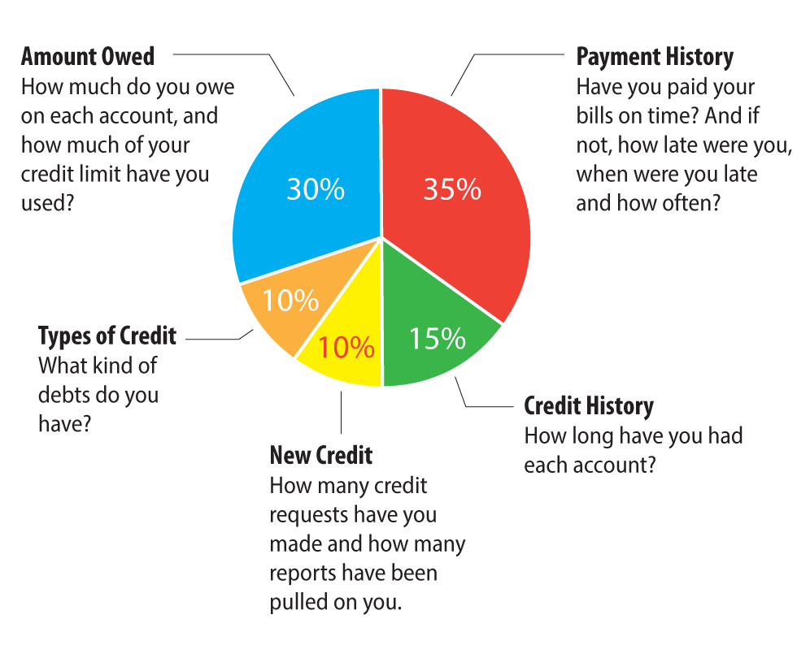

Slide 14
Case Study for discussion
Client has 846 credit score
No Retirement funds
Single and Self employed
20k in savings.
Reported Income is 93k
Wants to know her borrowing limit.
Qualified for funding or not?
If so what do I need to obtain from her?
What option(s) do I have to offer?

Slide 15
Case Study for discussion
Client has 809 credit score
88k in savings.
0 in retirement saving.
Married, 35 years old, Spouse is not working.
Owns a home.
Current household Income is 20k
Their non secured debt is at 67% utilization.
Are there any option(s)?
What should I advise?

Slide 16
Case Study for discussion
Client has 755 credit score
40k in a Roth IRA.
15k in savings.
Married, 38 years old. Spouse does not work stay at home mom with 2 kids less than 5 years old
Income is 75k
He is working but wants to leave to run the business full time.
His Credit Cards are at 35% utilization.
Has 4 years of credit history
Has 11 hard pull inquiries last .
How would you advise him? What option(s) does he have, what type of business would you show him if he qualifies?

Slide 17
Case Study for discussion
Client has 702 credit score
120k in a Non-Roth IRA.
Home owner but less than 20% equity in it.
DTI 11.52%
7 Years Credit History
2 disputed late payments in late 2022 sent to collection agency for $1,700 dollars and $681.00
Income is 70k
Not Married
Qualified or not for a loan?
Other Options?
What do you advise

Slide 18
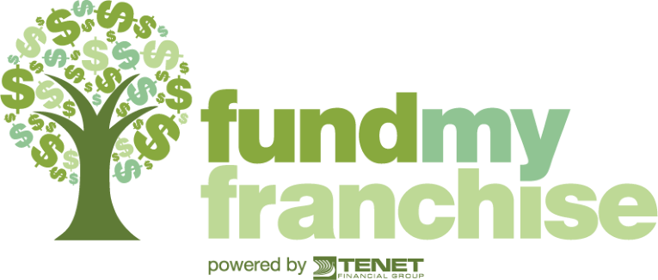
Questions?
Al Lesko
President of Fund My Franchise
541-831-0071 Office Line (Best Option)
541-973-0071 Text Messaging ( Please include your name)
www.fundmyfranchise.com

