Slide 1


Beyond Training
Becoming The Broker You Are

Slide 2

All potential future realities exist simultaneously in this moment.

Slide 3

“You need to learn to look beyond what you see.”

Slide 4
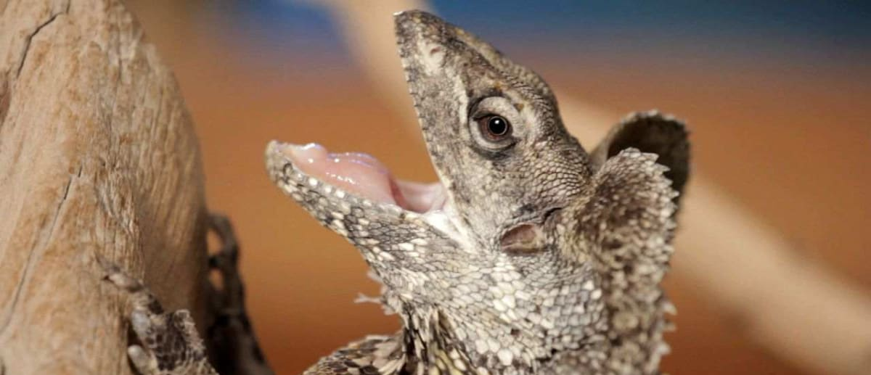
Seth Godin
Linchpin; Are You Indispensable
“The Lizard Brain is the reason you’re afraid, the reason you don’t do all you can.”

Slide 5

Steven Pressfield
The War of Art
“Resistance will tell you anything to keep you from doing your work.”

Slide 6

Steven Pressfield
The War of Art
“Resistance is always lying and full of shit.”

Slide 7

Wife Diagnosed With Cancer
Slow Lead Flow
Fired From Job Because of My Brokerage
No Closed Deals
Zero Income
My First Three Months

Slide 8
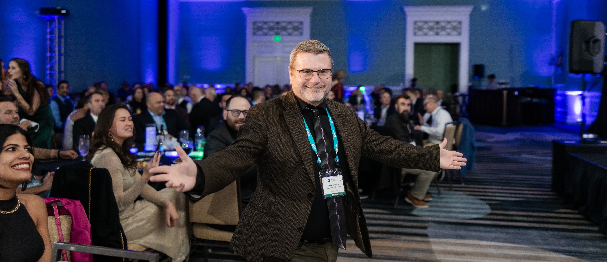
Six Closed Deals
Broker of the Month
Influencer of the Year
Exceeded Annual Salary
Added 3 Agents to the Team
The Next Four Months

Slide 9

For a moment she discovered the purpose of her life. She was here on the earth to grasp the meaning of its wild enchantment and to call each thing by its right name.
~Boris Pasternak
Dr. Zhivago
Your success begins with telling yourself and the world the right story today.

Slide 10

“I am a successful franchise professional according to the definition of success that originates from the most honorable and powerful version of myself.”
Write this down and keep it in a visible spot in your office every day.

Slide 11

Your “why” keeps your focus in the right direction and tells the world why they should pay attention to you.
Your Story
What is your why?

Slide 12
Quantum Franchise Group
Mission Statement:
We help aspiring business owners make the dream of business ownership a reality with outstanding franchise concepts.
Your Story
What is your why?

Slide 13
Quantum Franchise Group
Vision Statement:
By 2033 Quantum Franchise Group will have facilitated the opening of no fewer than 1,000 new business openings across the United States, leaving behind a legacy of positively changed families and communities.
Your Story
What is your why?

Slide 14

Existing Close Network
Begin with who you know.
Extended Network
People who know who you know.
Local Community
Strangers Nearby You Need To Know.
North American Community
The Other 370 Million People.
Your Story
Where will you be found telling your story?

Slide 15

LinkedIn
Live Webinars
Facebook
On-Demand Webinars
TikTok
Local Chambers
Instagram
National Chambers
Newsletter
Landing Pages
YouTube
Google
Your Story
How Will You Tell Your Story?

Slide 16

Kennected For LinkedIn
Paid Social Media Ads
Paid Google Ads
Substack (Newsletter)
Caasie.co (Billboards)
Capcut (Video Creation)
Camtasia (Webinar Creation)
Leadpages (Landing Pages)
Canva (Content Creation)
Google Analytics
Paid Leads
Your Story
What Tools Can You Use To Tell Your Story?

Slide 17

10 Leads Per Day
300 Leads Per Month
3,650 Leads Per Year
Conversion Rate
1/2%
Annual Closed Deals
18
Average Commission
All About Leads
$360,000 Annual
Your Why, Story, and Strategy Culminate In Leads

Slide 18

How Big Is
Your Brave?
Your Turn
What is your story and what are your first-year goals?

