Slide 1

April 2024 FTI Funding Training
Funding tips and tools you will use in your day-to-day consulting practice

Slide 2

Overview
Very simple: By asking and obtaining the right information at the right time will help you save a deal, close more deals, and close them quicker.
To accomplish this goal, you may need to develop a successful process.
You must understand the financial environment is always subject to ever changing conditions, what impacts these changes, what information is available, how to present the information, and information you need to obtain from them.

Slide 3
Questions we will cover
Why are seemingly good deals lost?
Why are SBA applications rejected by banks after a pre-qual? Is a pre-qual of any value?
My role as a broker in this part of the process? What is the franchise role?
What are my informational tools and how to present them to clients?
Timing is everything, why is that?
Types of funding. What do I need to know?
What are the new changes with lending SBA, IRA/401k rollovers, personal loan?
Rising interest rates and how to minimize a client’s concerns. Quick tip to ease your client’s concerns.
Economic conditions will dictate what funding sources people will need to consider
Tricks of the trade to use funding to move the deal to close sooner.
Debt-to-income
Monthly payments
$3,321.00
÷
Monthly income
$8,100.00
=
Debt-to-income Ratio 41%
Reducing your monthly payments by $424 will put your ratio at 35% (what lenders prefer).

Slide 4

Funding options for Franchise Investing
SBA Loans (Express Loan & SBA 7A)
IRA/401K Rollover (Not held with a current employer)
Personal Loans (Must have Documented Income)
Business loans (Must be in Business 2 years with Good Returns)
HELOC (Home Equity Line of Credit)
FFF (Friends, Family, Fools)
Self Funded (Should someone do this? Let’s discuss it)

Slide 5
SBA Loans
SBA Express
Complete Credit Report & Score of 680 or better.
25K total must use 11.1% cash to inject into the business and the remainder is the reserve liquidity. (Cash, Stocks & Bonds, IRA/401K)
SBA backs the loan 50%
Debt to Income ratio
Total Household Income
Assets (Liquidity) too much or too little can be a disqualifier
5 years of Credit Longevity & Depth in credit history
Payment history of the applicant
Any Derogatory issue on the clients
Generally, for Start ups (no build outs).
Resume (Managerial Experience)
Personal Financial Statement
3 years Tax Returns (Biz & Personal)
2 years of Projections (pro-forma) Bank Provides Template in most cases. Simple Business plan on bank template
No Felony convictions or Judgements in applicant’s history
Entity documentation, Articles of Information must match application and the industry on the loan application. Also, FDD & Agreement
SBA 7A
Complete Credit Report & Score of 680 or better.
Generally, 20% cash injected in the business, 20% in liquid reserves. Some Industries require less.
SBA backs the loan up to 80%
Debt to Income ratio
Total Household Income
Assets (Liquidity) too much or too little can be a disqualifier
5 years of Credit Longevity & Depth in credit history
Payment history of the applicant
Any Derogatory issues with the client
Used for Resales, Start ups, Expansions, and build outs
Resume (Managerial Experience)
Personal Financial Statement
3 years Tax Returns (Biz & Personal)
3 years of Projections (pro-forma), client must produce & Solid Business Plan including franchise history, vision, specific detail for their territory demographics
No Felony convictions or Judgements in applicant’s history
Entity documentation, Articles of Information must match application and the industry on the loan application. Also, the FDD and Agreement

Slide 6
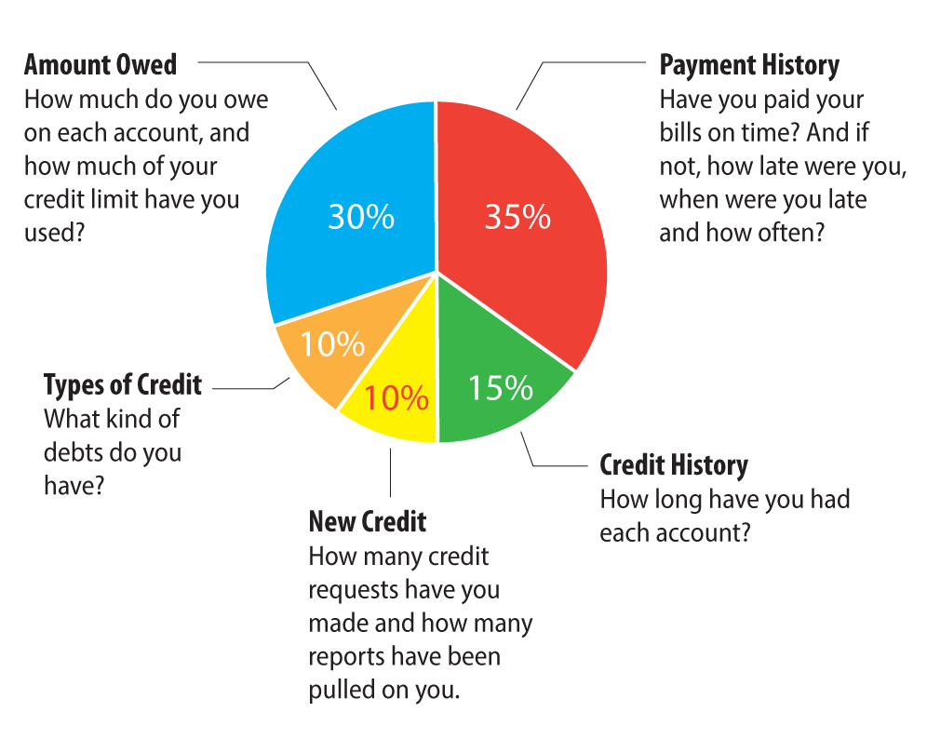

Slide 7

There is no standard Modus operandi
There is no set standard for banks or the SBA. Only minimum qualification terms
SBA rules can and so change often. Bank policies change often.
Special SBA incentives happen (we have this going on right now).
Banks are the ultimate decision maker on granting the loan.
Banks worry about their lending status with the SBA. The banks portfolio of loans performance is a determining factor for the bank to be allowed to fund SBA loans directly.
Supply and demand dictates changes for the bank and SBA. 2024 Banks are looking at depth and history more closely.
The Federal Reserve plays a huge role in the interest rate.
What funded last week by X terms may not apply tomorrow to the exact X terms.

Slide 8

Importance of Validation for SBA Loans
Applicants will be required to submit 2 years of projections for SBA Express loans and 3 Years of projections for SBA 7A Loans.
Applicants will need to submit a business plan for an SBA 7A loan and some banks are now requiring this for Express loans.
Applicants need to base both the projections and the business plan on factual data. They must coincide with each other.
It will help a client realize the effort needed to reach their income expectations and when, what the business can achieve, and what they can sell it for.
Because it is a CYA for you!

Slide 9
Fed Governor Says Small Businesses Need Access to Affordable Capital
“Of course, in order to create jobs, small businesses need access to sufficient amounts of affordable credit and capital to form, grow, and succeed. Otherwise, they may underperform, not reaching their growth potential either in revenue or employment. The share of small businesses reporting that they rely on personal sources for capital increased from about half in 2019 to two-thirds in 2022, according to the Fed’s Small Business Credit Survey (or SBCS) from that year. This suggests a high degree of personal risk for owners and their workers. Moreover, personal financial resources are often limited, which can constrain growth. Ideally, small businesses should be able to access external funding, which can be a key to their growth and stability,” says Governor Michelle Bowman of the Federal Reserve Board of Governors.

Slide 10
Aggressive Franchise Rep Pitches.
Don’t let your client Fall for it
We Need the Franchise fee paid in full before we can move forward.
We have multiple buyers interested and we are waiting on your decision.
Our funding source pre-qualified you so if you want this territory we will need the franchise agreement signed and a non refundable franchise fee paid before we can provide answers to any additional requests for information.

Slide 11
IRA/401K Rollover
Let’s keep it simple what is it?
Simply put in layman's terms it is the diversification of a retirement account that allows an individual to not only invest in stocks, bonds, mutual funds, gold, silver, or real estate but also into a business they own without incurring a tax penalty.
The process involves the creation of a qualified plan & setting up a C-CORP. This must be created by a Certified and 3rd party administrator, and the plan approved by the IRS. This plan must be managed by a 3rd party who is responsible for periodic testing for compliance and up to date with any tax laws that are applicable.

Slide 12
Benefits:
Tell me why I should consider it?
Can be used to start a business in combination with an SBA, Personal loan, or to solely fund a loan. Prospect will have less of a debt burden.
Allows a person to have more control of their retirement portfolio.
A business owner has a retirement plan that allows them to save up to $23,000 toward their retirement.
A business owner can match the employee’s contributions up to 100% (including themselves) out of the company earnings
A business owner can contribute an additional profit-sharing money to employees 401k accounts from the company earnings.
C-CORPS can carry over a loss for 3 years and has more tax deductions than the other entity option.
The amount of stock owned by the 401k is except from capital gains tax at the time of sale, so long as the money is diverted back into the 401k for other investments. This includes another or a future business purchase.

Slide 13

Qualifiers
We recommend a client has 35k or more in a non-Roth IRA.
A 401k with a current employer is not eligible unless the employer plan allows for withholding directed to an employees own qualified plan.
Must be set up as C-CORP. Yes, there are some companies promoting Single Payer S-Corps and Roth S-Corp plans. Another conversation to discuss why I don’t recommend them.
It must be created, managed, and maintained by a 3rd party administrator throughout the existence of the company.
Requires an initial stock valuation, and one done every year thereafter.

Slide 14

Personal & Business Loans (Non-SBA)
Personal loans are just that, a loan to an individual based upon similar criteria as the SBA loans. The difference is they are shorter fixed rate term loans. Typically, 3 to 7 years, with 5 years the most common.
They do not require any money out of pocket (other than a 1500 non- refundable deposit).
The rates usually are between 10.5% to 16%. Depending on the Strength of the borrower’s financial profile.
The funds usually take between 3 weeks to fully fund. They may require 1 or more applications to achieve the amount of funding a person needs.
Business loans require at least 2 years in business with strong financials. The goal is to start with a personal loan and migrate to a business loan.

Slide 15
Case Study 1 for discussion
Clients are young and have 6 years of good credit history. Scores 754 and 744.
Combined employment income 275k. Separately 100k and 175k
200k in savings. 75k each in an Non Roth IRA.
Receiving 100k gift from the husbands parents.
Debt to income not including real estate 25%.
Home owners with rental income. Net profit 1500 monthly.
Monthly income vs Expenses leaves 5000 disposable income.
Wants funding for a 3 pack start up Medical franchise with only 20 units open and none of them open more that 3 years. Total Investment 600k to 700k. Franchise Fee for 3 = 100k
What are the challenges with the bank?

Slide 16
Case Study #1 Project Breakdown
Total savings 200k
Total eligible retirement funds 150k
Total eligible Gifted Cash from immediate family 100k
Total liquidity 450k
Yearly gross income 287k
Total monthly net after household expenses 5000.
SBA Loan Payment on $xxx borrowed =

Slide 17
Case Study
SBA Loan payment on 600k at 11.25% = $8,350. @ 10 years
SBA Loan payment on 500k at 11.25% = $6,958. @ 10 years
SBA Loan payment on 400k at 11.25% = $5,567 @ 10 years
SBA Loan payment on 300k at 11.25% = $4,175. @ 10 years
SBA Loan payment on 250k at 11.25% = $3,479 @ 10 years
What can they afford?
What should your funding source suggest as options and as a strategy?
How can you help as a broker to get this deal done?

Slide 18

Questions?
Al Lesko
President of Fund My Franchise
541-831-0071 Office Line (Best Option)
541-973-0071 Text Messaging ( Please include your name)
www.fundmyfranchise.com

