Slide 1
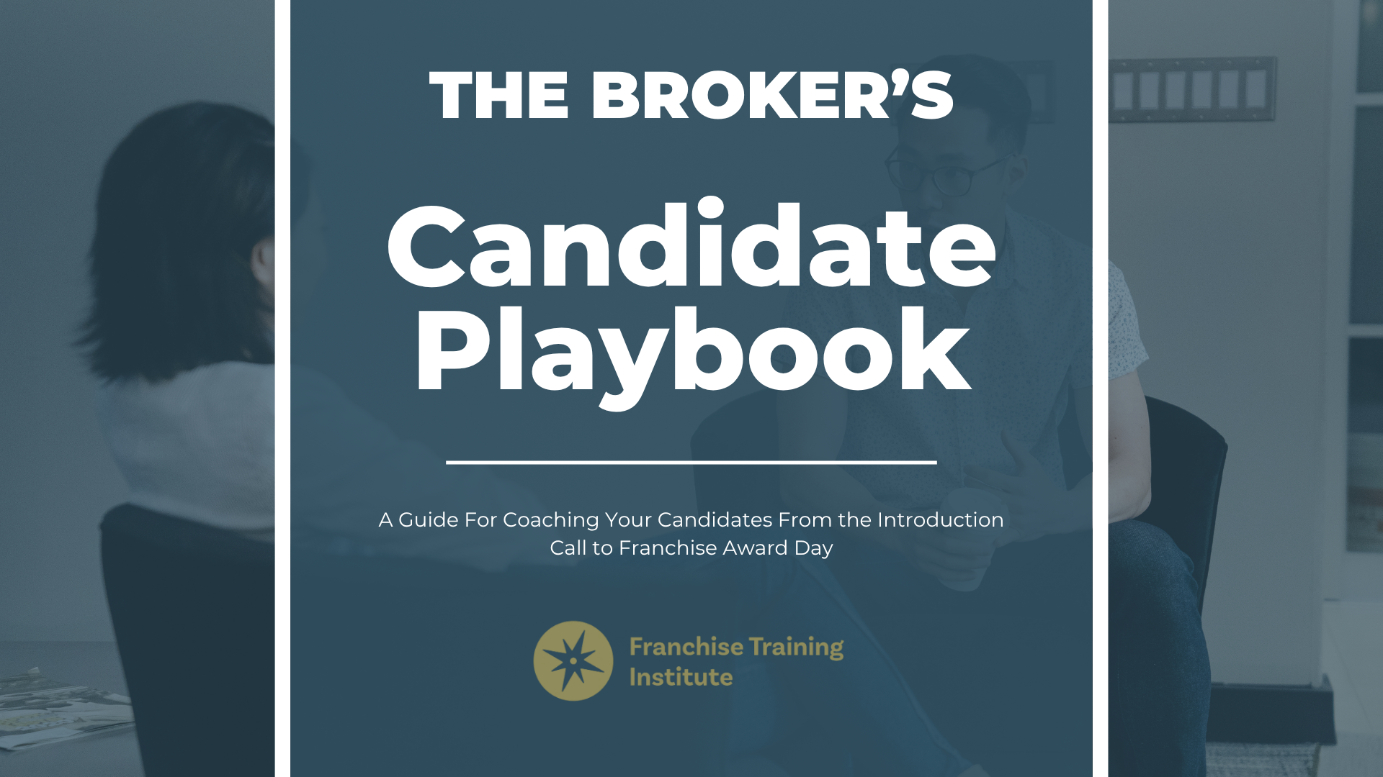

Presented By: William Huffhine

Slide 2
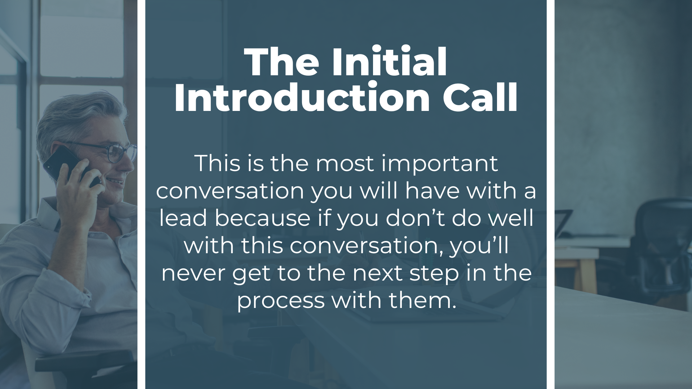
Presented By: William Huffhine

Slide 3

Three Goals of the Initial Introduction Call
1
Build Trust
Every lead comes to you with their guard up.
2
Discover Mindset, Motivation, and Money
Every lead comes to you with a desire to pursue pleasure and avoid pain.
3
Set the Stage For a Brand Presentation Meeting
Every lead comes to you with their guard up.
Schedule The Next Meeting Before This One Ends!
Presented By: William Huffhine

Slide 4
How Trust is Built From The First Call
1
Establish Rapport
Find something in common to talk about so they see you as a real person.
2
Help Them Understand You and Your Business
Tell them a little about yourself, your business, and your “why.”
3
Explain The Process You Will Guide Them Through
Help them understand all the steps from today through award day.
4
Request Their Permission to Move Forward
This shows them that they are in control and you’re there to serve them.
Schedule The Next Meeting Before This One Ends!
Presented By: William Huffhine

Slide 5
Questions To Ask To Learn Motivation
1
Their Job and Career
What do you do for work now? Tell me about your career.
Their Pain or Dreams of a Different Future
What’s happening in your career or life that is prompting you to consider opening a business?
2
3
Their Understanding of Franchising
What do you know about franchising? Why are you considering this path?
Schedule The Next Meeting Before This One Ends!
Presented By: William Huffhine

Slide 6
Questions To Ask To Learn Mindset
1
Ownership Type
Do you want to be the daily operator of the business? Do you need something semi-passive from onset? Do you want to build an empire?
Industries of Interest
What kinds of business can you envision yourself enjoying and thriving in? Reassure them that they usually don’t need experience with the industry.
2
3
Timing
How soon would you like to be open for business? Explain the 1-3 month due-diligence process, training, and preparation for grand opening.
Schedule The Next Meeting Before This One Ends!
Presented By: William Huffhine

Slide 7
Questions To Ask To Learn About Money
1
Liquid Capital
Can you tell me how much capital you have easy access to? Ask about cash, investments, equity, and retirement. Explain minimum requirements.
2
Maximum Investment
Can you tell me the maximum amount you’re comfortable investing in a business? Explain what all is included in the investment. Mention financing.
3
Credit Score
What is your current credit score? Explain the minimum required for utilizing SBA lending.
4
Net Worth
Can you tell me where your net worth is today? Explain that this is just a qualification question as there are minimum requirements.
Schedule The Next Meeting Before This One Ends!
Presented By: William Huffhine

Slide 8
Closing The Conversation
1
Explain What Comes Next
Explain that you’ll be sending them the Zorakle and explain what it is and why we use it.
Ask If They Have Questions
Offer to answer any questions about franchising in general, you personally, or the process you’ll take them through.
2
3
Schedule Zorakle & Industry Call (optional)
Some brokers schedule a second meeting to review the Zorakle results and walk them through a rating of each of the industries.
Schedule The Brand Presentation Meeting
Presented By: William Huffhine

Slide 9
Keep Your Candidate Engaged
1
Engagement Sequence
Enroll them in the “Preparing for Brand Presentation” sequence.
Lead From The Front
Keep the process moving forward by scheduling every next conversation before ending the current one.
2
3
Manage Their Mindset
Encourage, praise, and cheer them on. Call out bad habits, behavior, and stall tactics. Help them name and deal with fear at each step.
A Deal on Auto-Pilot is a Deal That Probably Won’t Close!
Presented By: William Huffhine

Slide 10
Your Final Steps
1
Enter All Candidate Information Into HubSpot
2
Create a Deal in HubSpot
3
Push the Record to FBA Members
4
Begin Your Research!
Presented By: William Huffhine

